Slide 1


DARS
UPDATES

Slide 2

Content
Memory Refresher
Prototype demonstration
Explanation
QUESTIONS ( help us!)

Slide 3

1. Updates

Slide 4
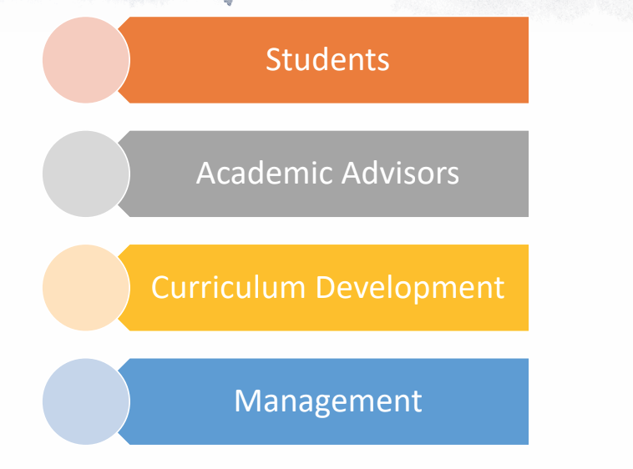
Memory Refresher
Topic Modelling
Sequential Pattern mining
LDA
CSPADE
The System
Stakeholders

Slide 5
2. Prototype

Slide 6
3. Explanation

Slide 7
Topic Modelling
Input Text
Course Manuals
Course Catalogue
Apply LDA
Number of topics from 5 to 250 by 5
Evaluate Performance over n topics
Perplexity
Log Likelihood
Tests
Keep model with ideal number of topics
Clean Text Data
Lowercase
Stemming
Use Beta and Gamma Distributions
Match courses to students

Slide 8
Input Text
Course Manuals
Course Catalogue
Apply LDA
Number of topics from 5 to 250 by 5
Evaluate Performance over n topics
Perplexity
Log Likelihood
Tests
Keep model with ideal number of topics
Clean Text Data
Lowercase
Stemming
Use Beta and Gamma Distributions
Match courses to students

Slide 9
Input Text
Course Manuals
Course Catalogue
Apply LDA
Number of topics from 5 to 250 by 5
Evaluate Performance over n topics
Perplexity
Log Likelihood
Tests
Keep model with ideal number of topics
Clean Text Data
Lowercase
Stemming
Use Beta and Gamma Distributions
Match courses to students
How do we select ideal number of topics?
Slow evaluation
Can we use your hardware to run k-fold cross validation?

Slide 10
Sequence Mining
Input Transcripts
2014-2018
Apply CSPADE
Clean Rules
Count > 20
Log Likelihood
Tests
Select rules for Red Flags
Clean Text Data
Grades
Taken Not taken
Use Rules to Output Redflags
Match rules to prospective transcript
Pass Fail
Low High
Confidence > 0.4
Lift > 1
E.g.:
if FAIL => FAIL
if NOT TAKEN => FAIL

Slide 11
Input Transcripts
2014-2018
Apply CSPADE
Clean Rules
Count > 20
Log Likelihood
Tests
Select rules for Red Flags
Clean Text Data
Grades
Taken Not taken
Use Rules to Output Redflags
Match rules to prospective transcript
Pass Fail
Low High
Confidence > 0.4
Lift > 1
E.g.:
if FAIL => FAIL
if NOT TAKEN => FAIL
Small samples
Big count = no rules
Small count = irrelevant rules
Override rules? Alternative Paths?
Cold Start Problem
New courses?

Slide 12
Thank you!
Sofia Vazquez Alferez
sofia.vazquezalferez@maastrichtuniversity.nl
Raphaël Morsomme
raphael.morsomme@maastrichtuniversity.nl

